Slide 1



Quora Question Pair
Duplicate or not duplicate

Slide 2
PROJECT SCOPE
About Quora
Online question-answer platform
Objective
Provided question in pairs
Identify whether question is duplicate or not
Quora allows one version of each question

Slide 3
ABOUT DATASET
Dataset obtained from Kaggle.
Part of Kaggle competition
Training set – 400,000 + rows
Testing set – 2.3 million + rows
Testing set missing labels – Not considered for the project
Training set split into stratify sampling to evaluate model

Slide 4
ABOUT DATASET
Fields
Unique ID for each pair
Q1 Id
Q2 Id
Q1 - Text
Q2 – Text
Label – 1 for duplicate and 0 for non duplicate

Slide 5

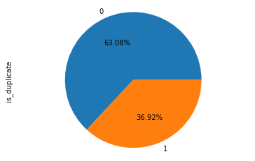



Distribution of labels

Slide 6
Data Cleaning Methodology
Human generated text contains Non-Ascii Characters
Removed question marks and punctuation
Stemmer and Stop words
Replace words like ‘1k’ and ‘1m’ with proper digits
Repalce “n’t” with “not”
Lower case
Replace Roman Numerals with digits

Slide 7
Descriptive Statistics of Data
 | Word Count | Character count
Maximum | 237 | 1169
Average | 11.07 | 59.82
Minimum | 1 | 1

Slide 8
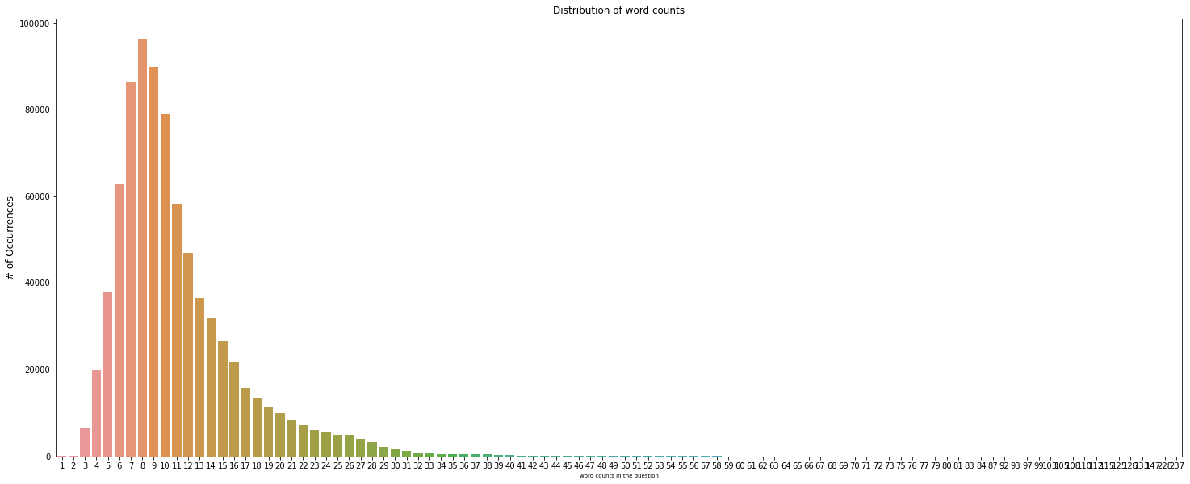
Distribution of Number of Words

Slide 9
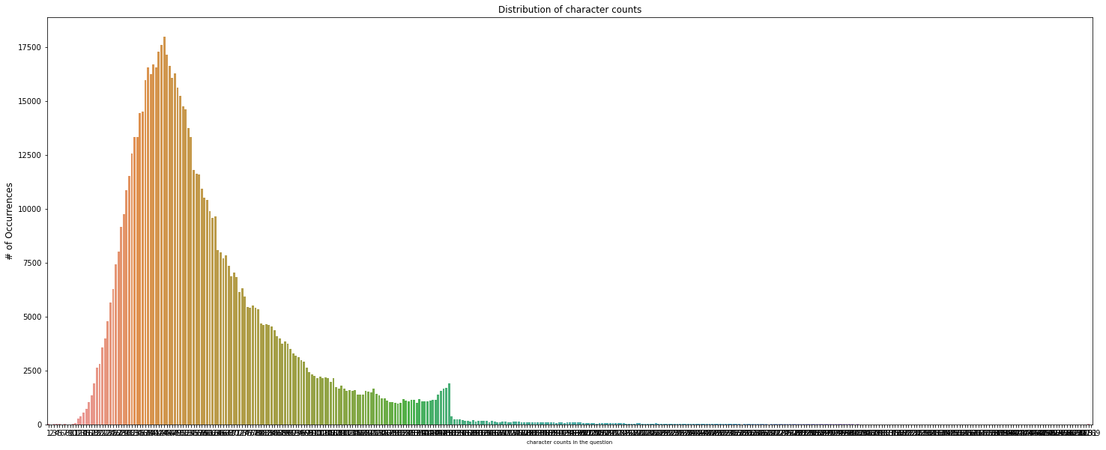
Distribution of Number of Characters

Slide 10
Minimum characters to define questions
Questions with less than 10 characters were ignored
After applying stammering and stop words removal, 228 rows of questions had no words
Drop all questions with less than 10 characters
Drop all questions that has no words (after applying stammering and stop words)

Slide 11
Common word Statistics
 | No. of Question Pairs
Has zero common words | 42,398
Has At least one common word | 361,558

Slide 12
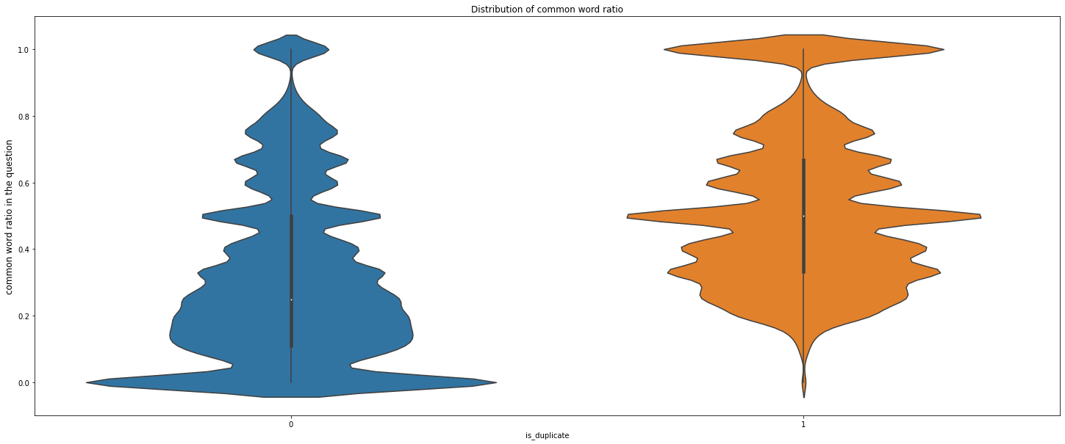
Distribution of common words ratio
COMMON WORD RATIO =
COMMON WORD IN PAIR/AVERAGE NUMBER OF WORDS

Slide 13
Train and Test Data set
Stratify sampling with test size = 0.3
Only 40% of data is used for developing machine learning model due to resource limitation

Slide 14
Feature Development
Word Embedding
GloVe model is used
Vecotorized representation of Text
Similarity Raios using FuzzyWuzzy
Fuzz ratio
Fuzz partial ratio
Fuzz sort token ratio
Common word ratio

Slide 15
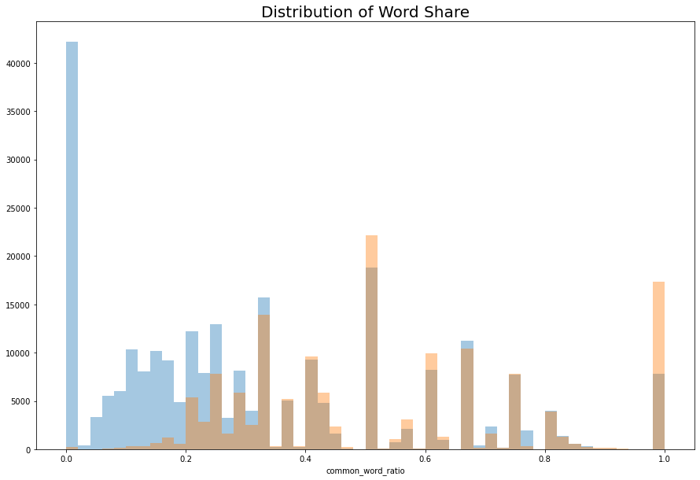
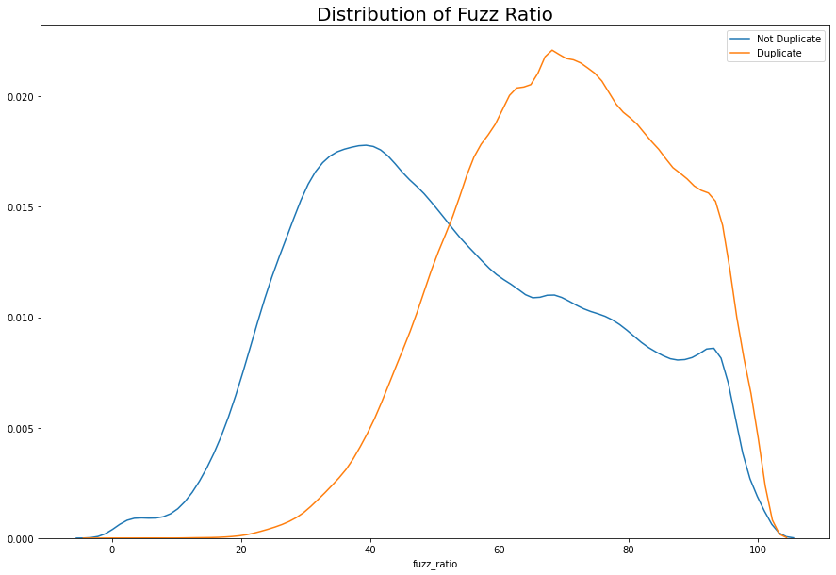
Feature distribution

Slide 16
Machine Learning Model
X data set
Word vecotrs
Fuzz ratios
Common Word Ratio
Y dataset
Duplicate or Non Duplicate
Scaling of Data Set using standard scaler

Slide 17
Machine Learning Model
List of Models
SGD Classifier using Logistic Regression
Gradient Boosting using XGBoost
Random Forest Classifier
Grid search is performed for each model
Metrics of Evaluation
Accuracy
F1 Score
ROC / AUC Curve for each model

Slide 18
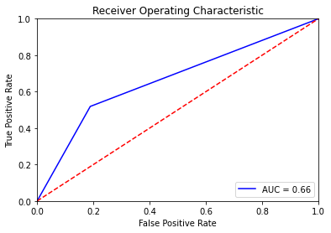
SGD Classifier using Logistic Regression
Train Accuracy = 0.702
Test Accuracy = 0.701
Confusion Metrics for Test Dataset
Class | Precision | Recall | F1-Score | Support
Not Duplicate | 0.74 | 0.81 | 0.78 | 30604
Duplicate | 0.62 | 0.52 | 0.56 | 17871
Weighted Avg | 0.7 | 0.7 | 0.7 | 48475

Slide 19
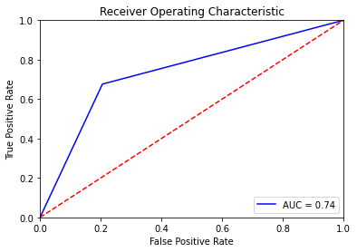
Gradient Boosting using XGBoost
Train Accuracy = 0.786
Test Accuracy = 0.751
Confusion Metrics for Test Dataset
Class | Precision | Recall | F1-Score | Support
Not Duplicate | 0.81 | 0.79 | 0.8 | 30604
Duplicate | 0.66 | 0.68 | 0.67 | 17871
Weighted Avg | 0.75 | 0.75 | 0.75 | 48475

Slide 20
Random Forest Classifier
Train Accuracy = 0.998
Test Accuracy = 0.774
Confusion Metrics for Test Dataset
Class | Precision | Recall | F1-Score | Support
Not Duplicate | 0.8 | 0.86 | 0.82 | 30604
Duplicate | 0.72 | 0.62 | 0.67 | 17871
Weighted Avg | 0.77 | 0.77 | 0.77 | 48475

Slide 21
Conclusion
Random forest Performs better compared to XGBoost and SGD classifier
Max features = 25 and number of estimators = 50

Slide 22
Future Scope
Try to use different combination of features for different models
Run models using full datasets

